Slide 1


Analyzing Amazon Sales Data

Slide 2
Introduction
My name is Deepak Gupta and I am work in Unified Mentor Pvt. Ltd. as a Data Scientist intern. I am select this project during the internship because I feel this is a very interesting project for learn something new skills for my future. This project is related to E-commerce domain.
E-commerce, or electronic commerce, is the buying and selling of goods and services online. It can take many forms, including online shopping, digital downloads, online subscriptions, and online ticketing. E-commerce can be conducted over computers, tablets, smartphones, and others smart devices.
Amazon (Amazon.com) is the world’s largest online retailer and a prominent cloud service provider. Originally starts as an online bookselling company. Amazon has morphed into an internet-based business enterprise that is largely focused on providing e-commerce, cloud computing, digital streaming and artificial intelligence (AI) services.

Slide 3
Project Details
Project Title | Analyzing Amazon Sales Data
Technologies | Data Science
Domain | E-commerce
Project Difficulties Level | Advanced
Tools | Python (Jupiter Notebook), Microsoft PowerBI, Microsoft Power Point, and Microsoft Excel

Slide 4
Objective of the Project
Finding Sales and Profit Trends month wise, year wise, Yearly month wise.
To understand how was the sales of different Items.

Slide 5
Problem Statement
Sales management has gained importance to meet increasing competition and the need for improved methods of distribution to reduce cost and to increase profits. Sales management today is the most important function in a commercial and business enterprise.
Do ETL: Extract-Transform-Load some Amazon dataset and find for me Sales-trend -> month-wise, year-wise, yearly_month-wise.
Find key metrics and factors and show the meaningful relationships between attributes.

Slide 6
Dataset Information
This is a sales related dataset that contains information like Country, Item Type, Sales Channel, Unit Sold, Unit Price, Unit Cost, Total Revenue, Total Cost, Total Profit, etc.

Slide 7
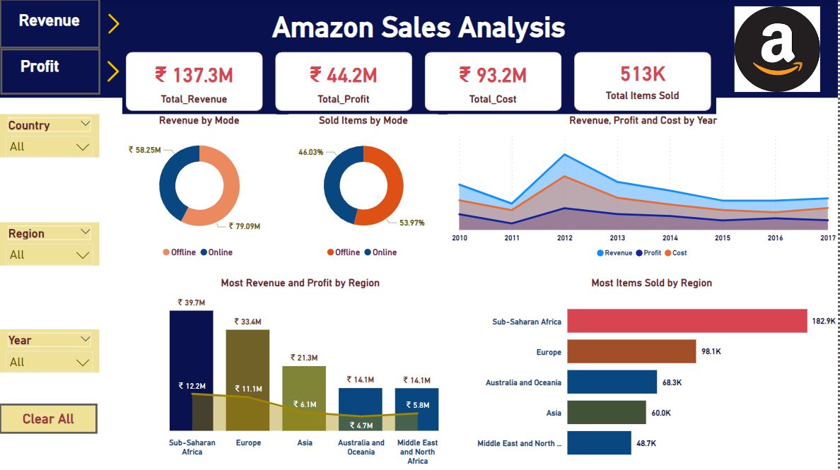
Amazon Overall Report

Slide 8
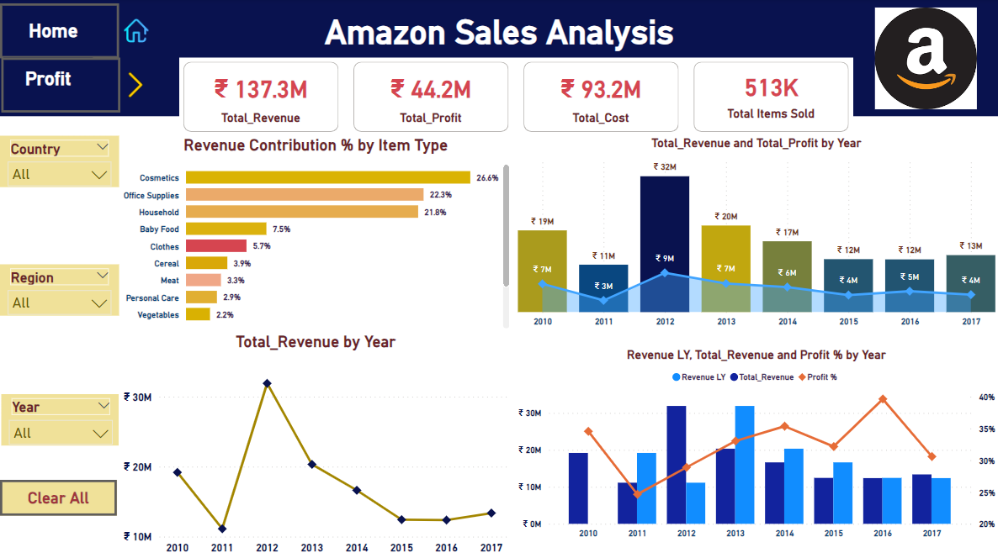
Revenue Analysis

Slide 9
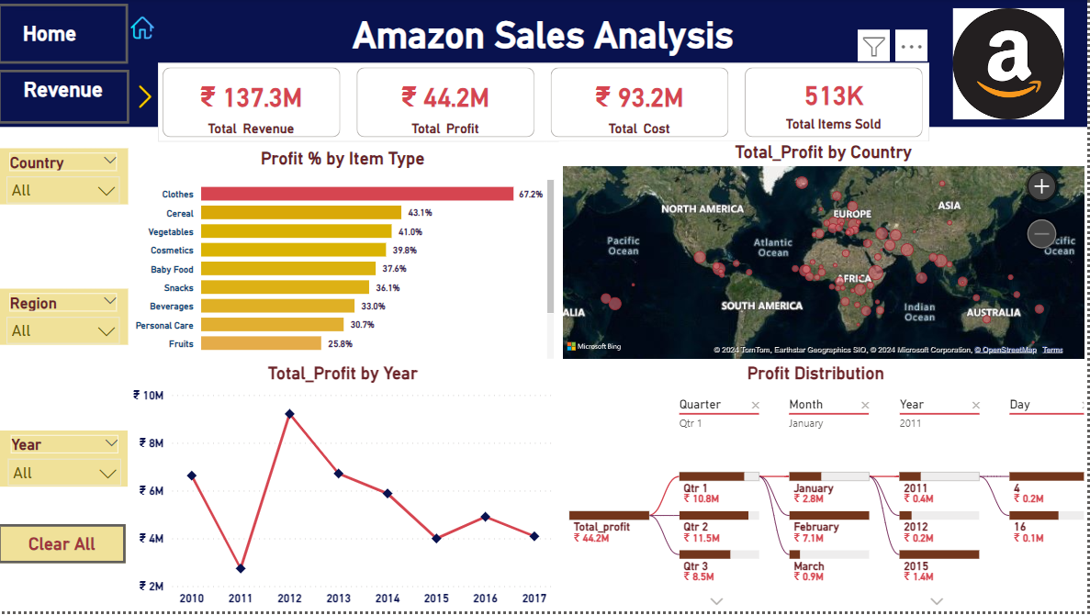
Profit Analysis

Slide 10
Thank You
Detailed Project Report Submitted by
Deepak Gupta

